Slide 1

Visual of 1-bit ram
John Zigrest

Slide 2
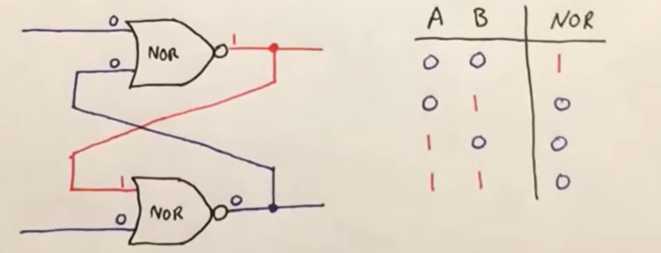
What is a SR latch?
SR stands for Set and Reset
It is made from two cross-coupled NOR logic gates
the output of each gate feeds back into the other, the circuit can remember its last state even after the input changes.

Slide 3
How is this 1-bit Memory?
A bit can only be 0 or 1.
The SR latch stores exactly one of those two states at its output, usually called Q.
If I use the Set input, the latch stores a 1. If I use the Reset input, the latch stores a 0.
After removing the input, the latch keeps that value because of the feedback in the circuit.

Slide 4
Truth Table
S | R | Q(next) | Meaning
0 | 0 | Q(prev) | Hold / memory
1 | 0 | 1 | Set
0 | 1 | 0 | Reset
1 | 1 | Invalid | Forbidden / unstable state
S = Set, R = Reset, Q(next) = new output, Q(prev) = previous stored value

Slide 5
